Slide 1
Chester Square Neighbors
Public Right-of-Way
NU 9/27/2019

Slide 2
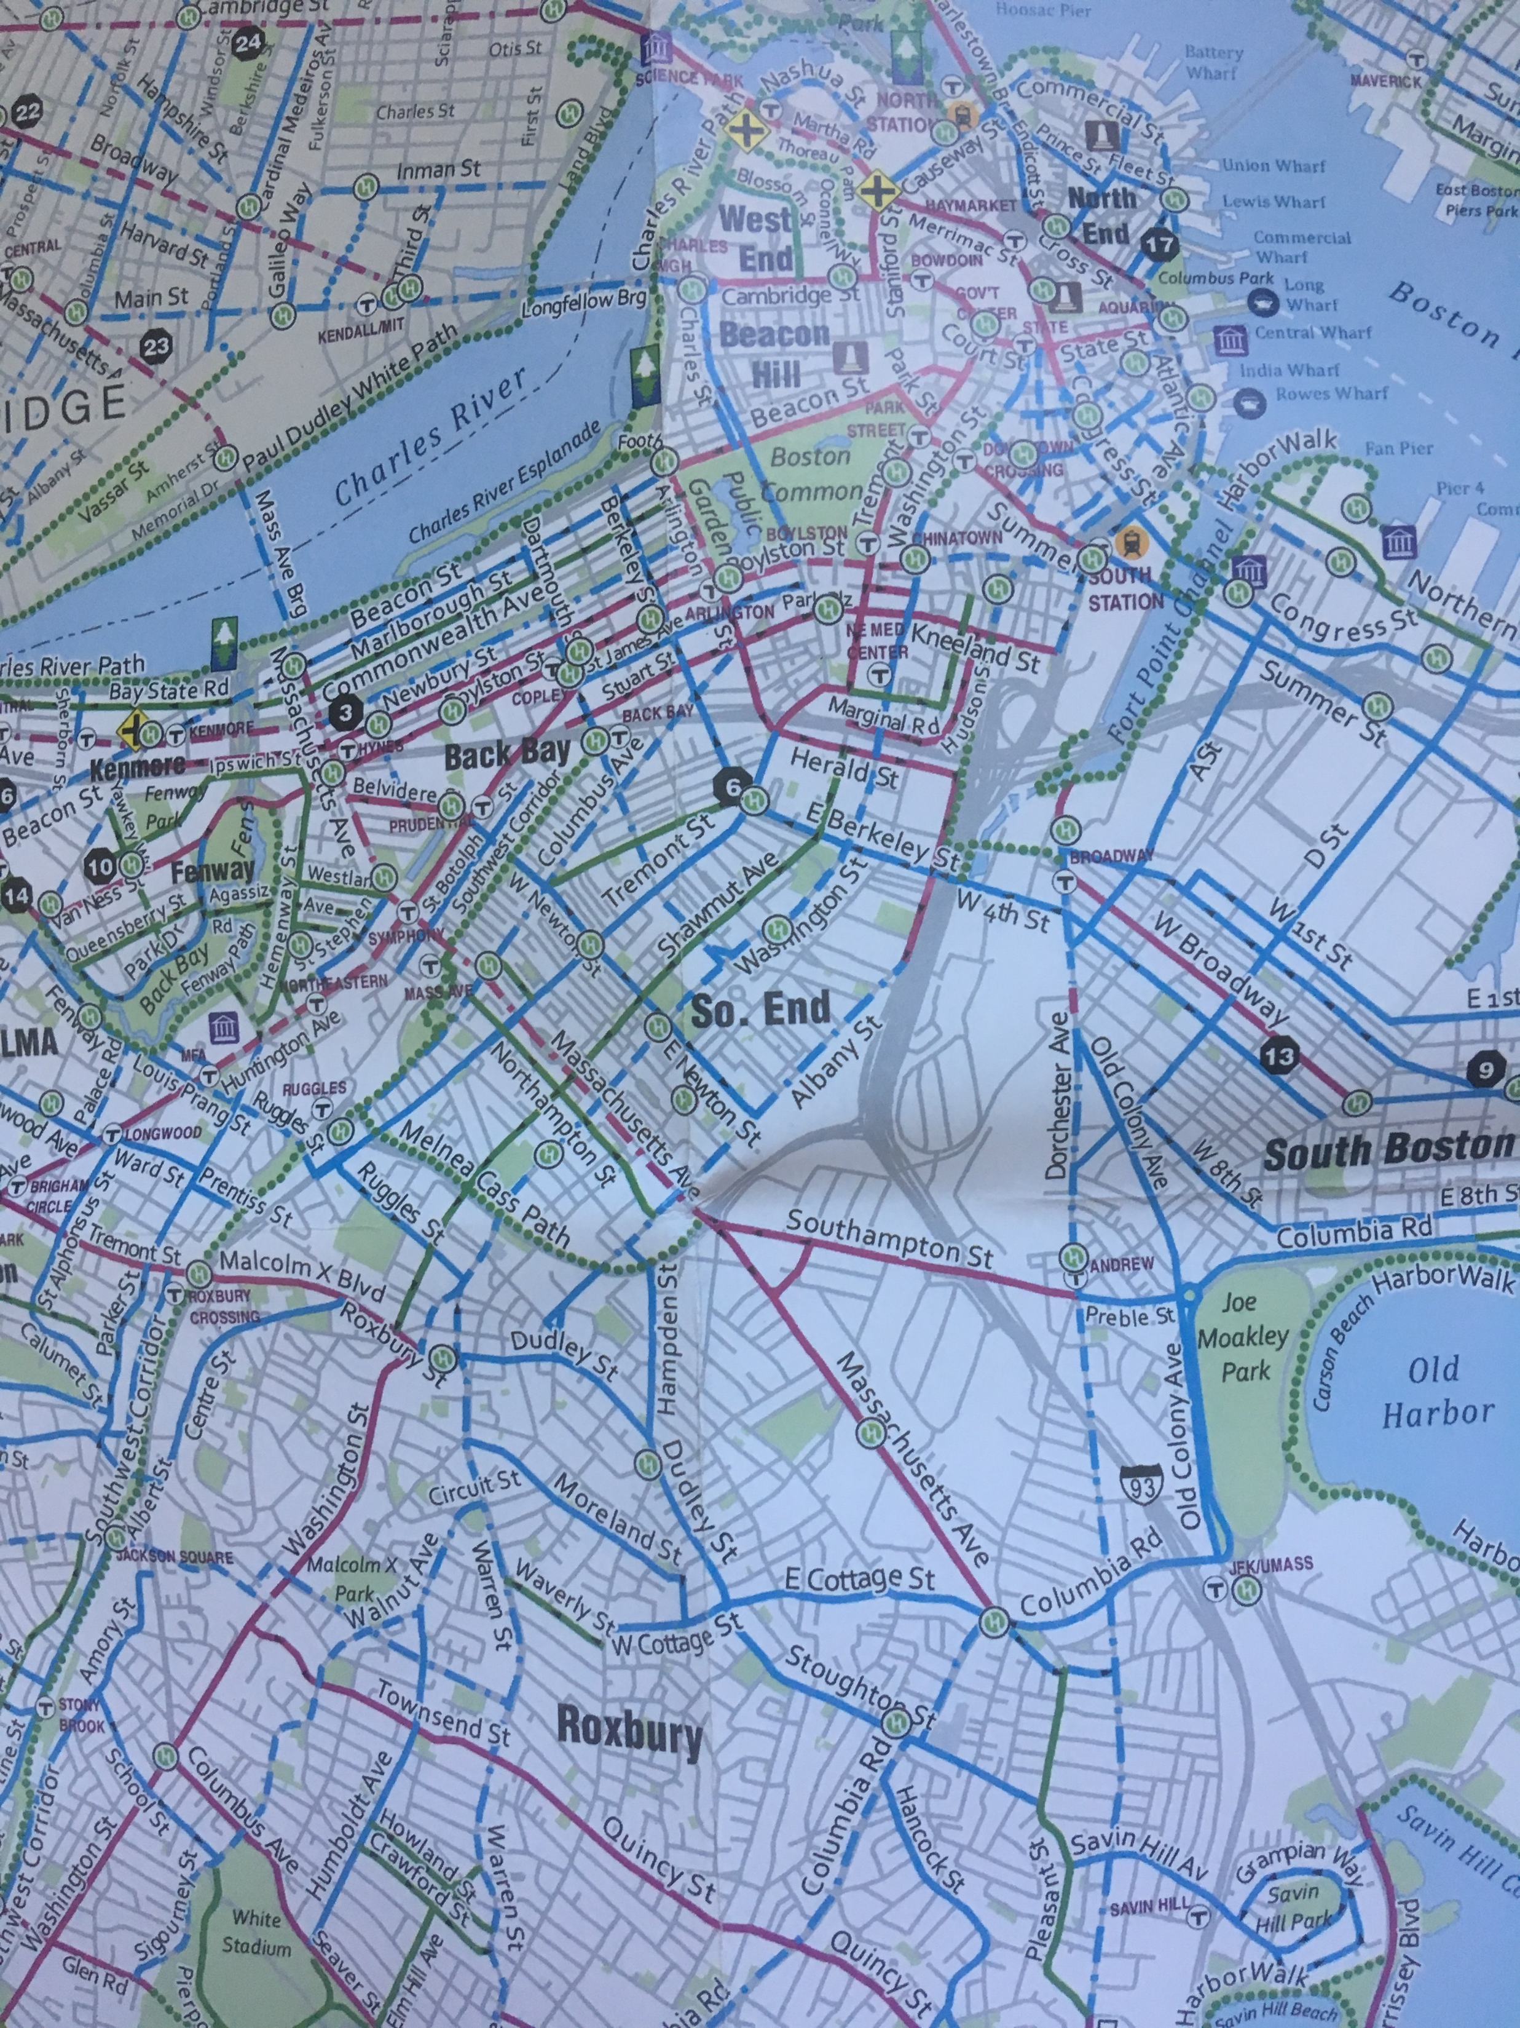
Boston Bikes
2013

Slide 3
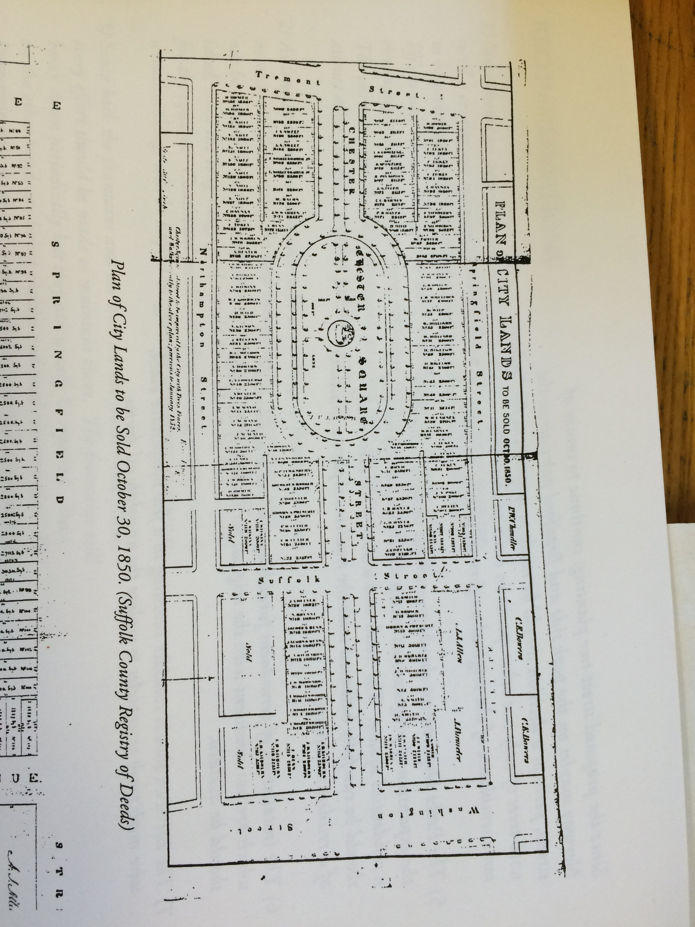
1850
City of Boston
City Lands to be Sold

Slide 4
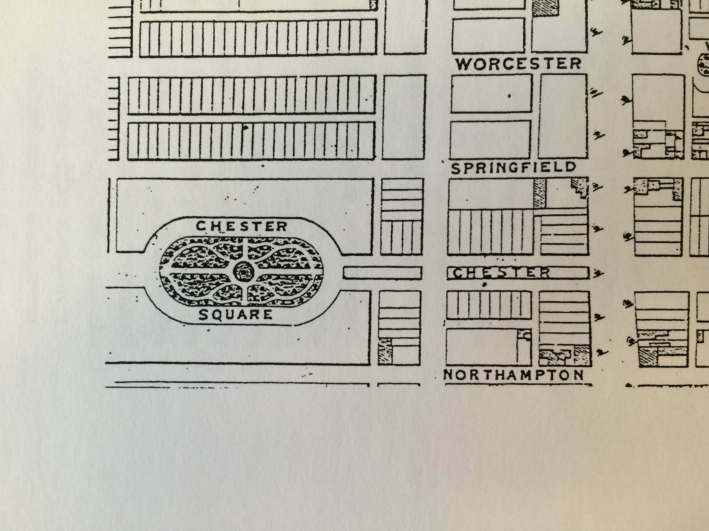
Chester Park
Boston Public Works
original plan

Slide 5
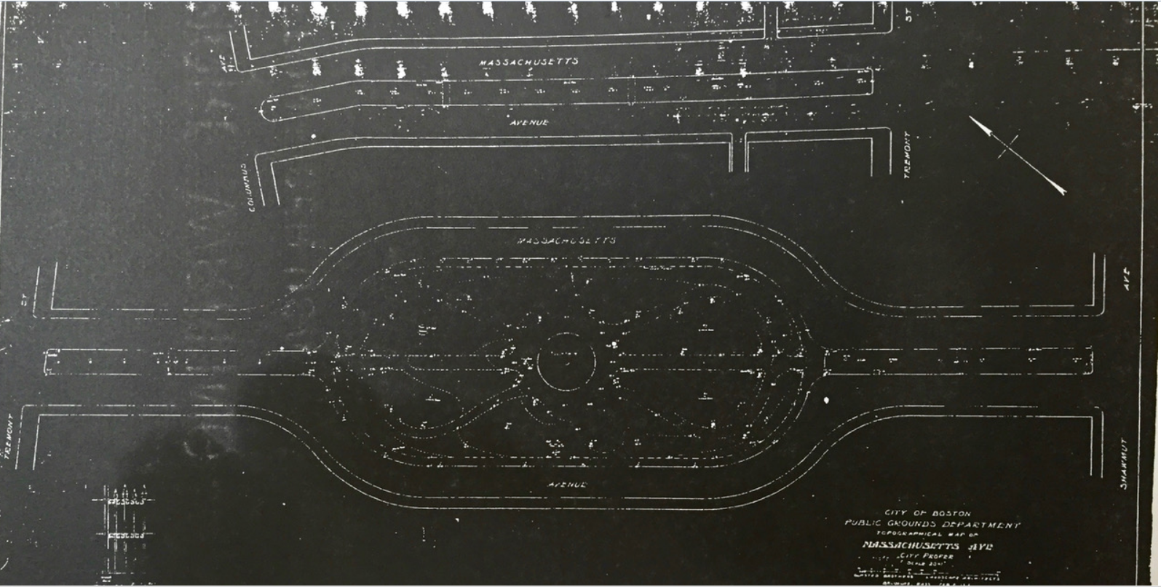
1913
Olmsted Brothers

Slide 6
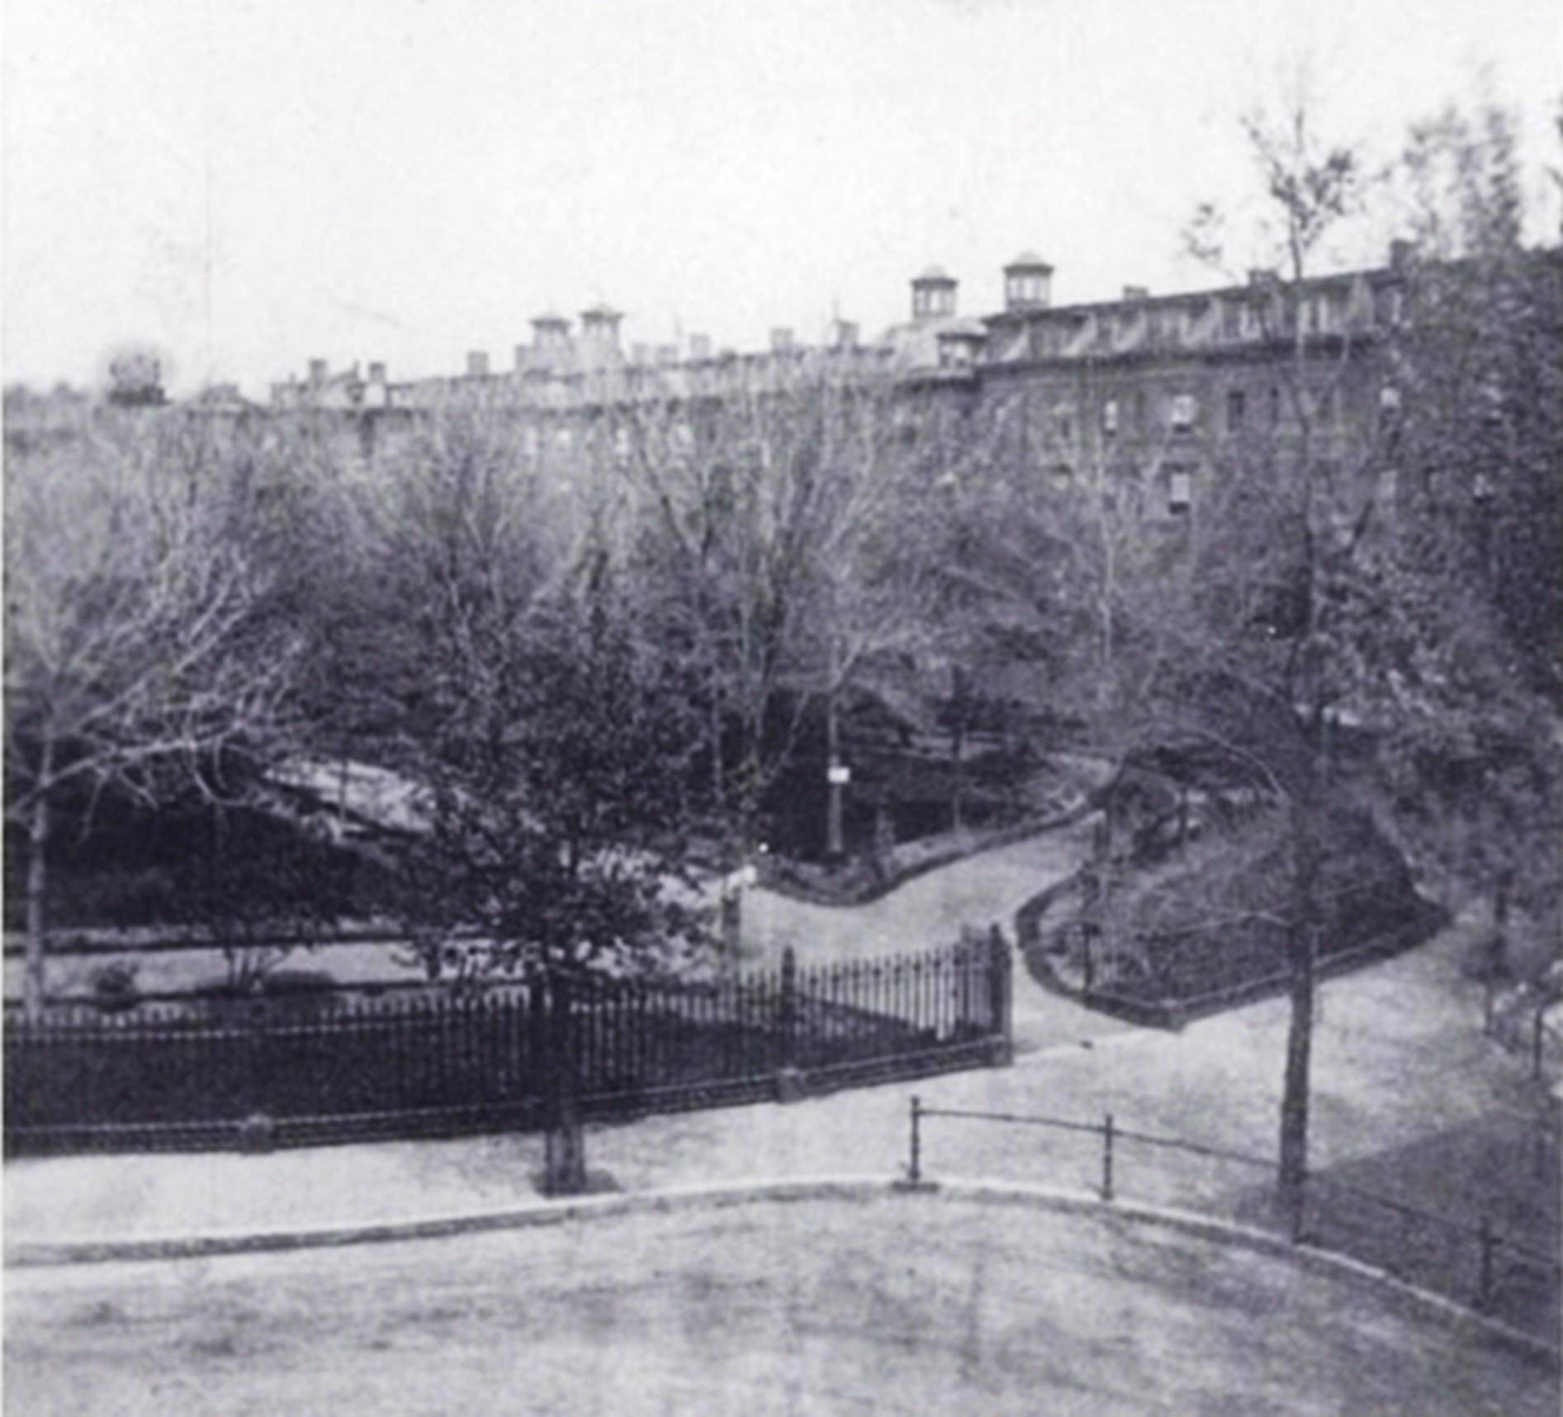
View from a home
on Chester Square
Thanks to Roberto Poli

Slide 7
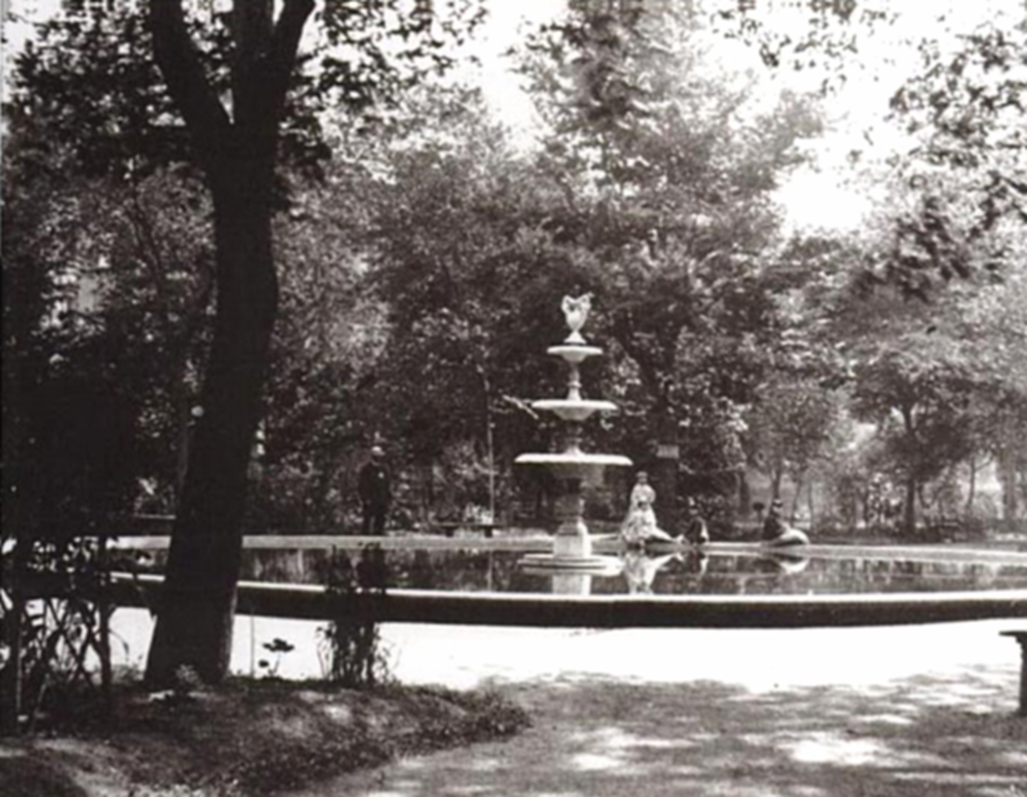
Chester Park’s
original fountain

Slide 8
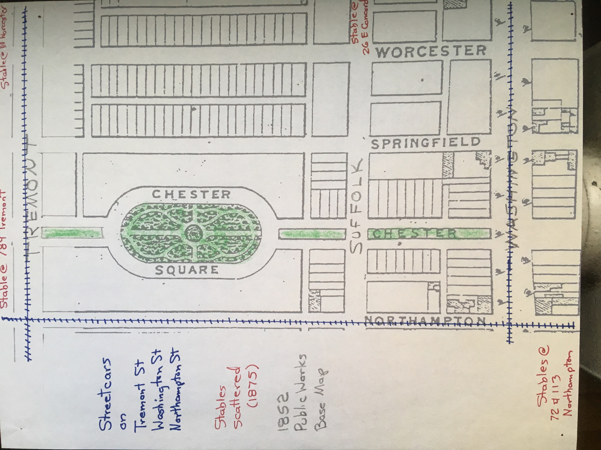
Transportation in the late 1800’s

Slide 9
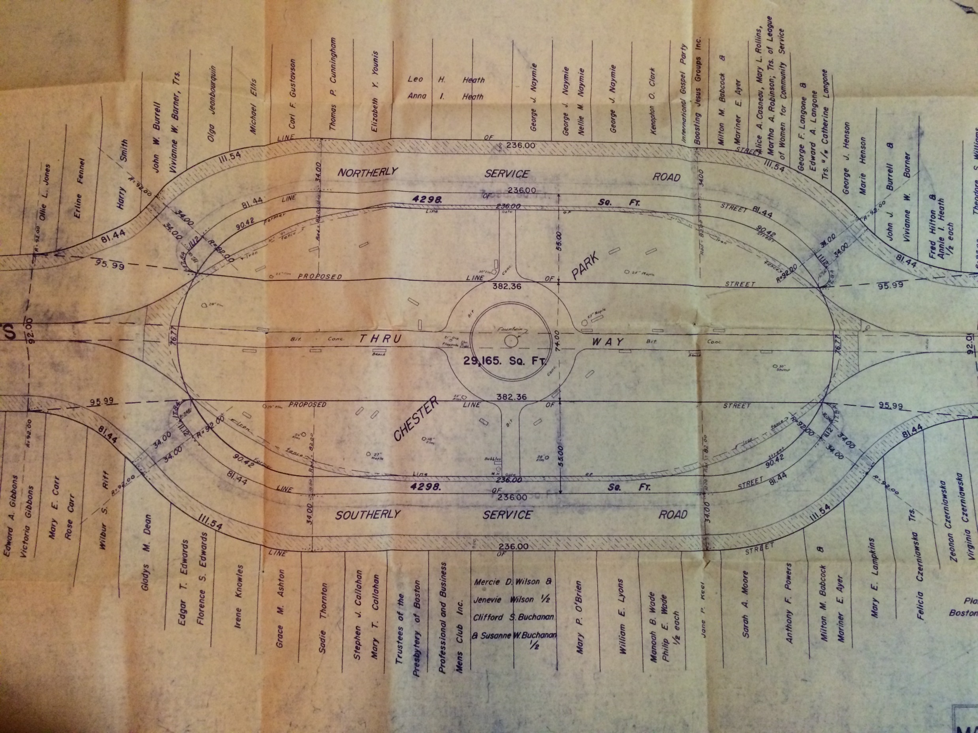
1952 Plan
Highway cuts
through Chester Park

Slide 10
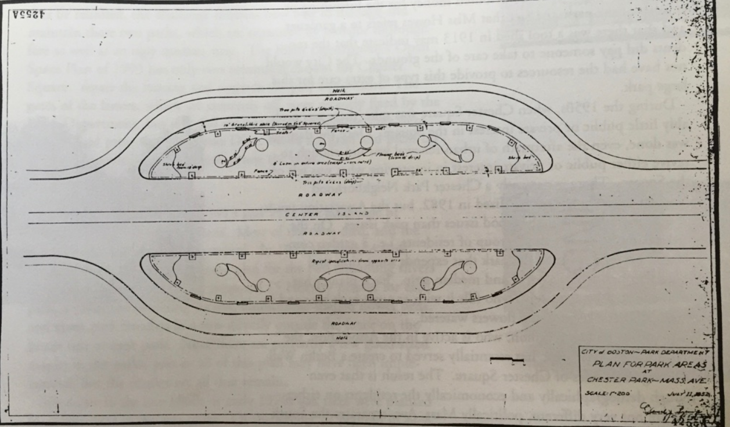
Plan for Chester Park 1952

Slide 11
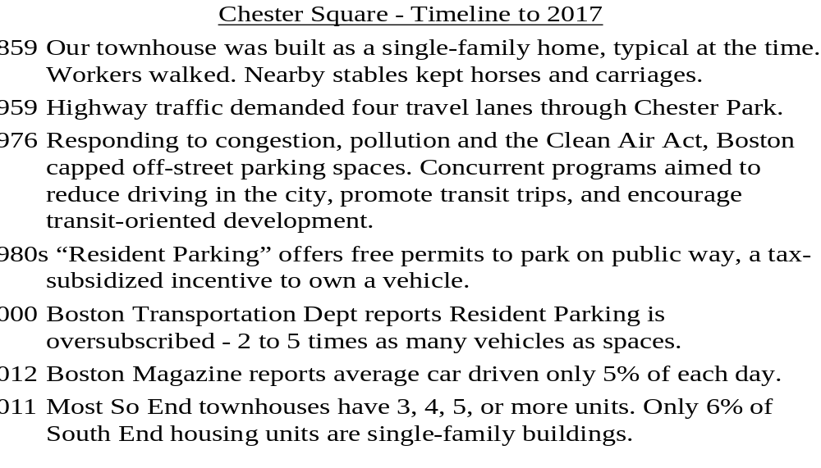

Slide 12
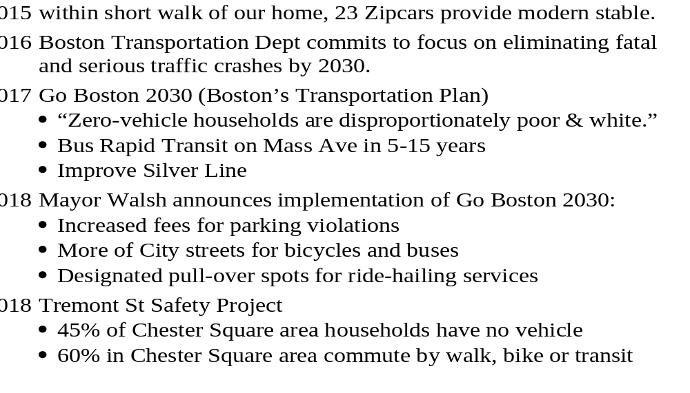

Slide 13
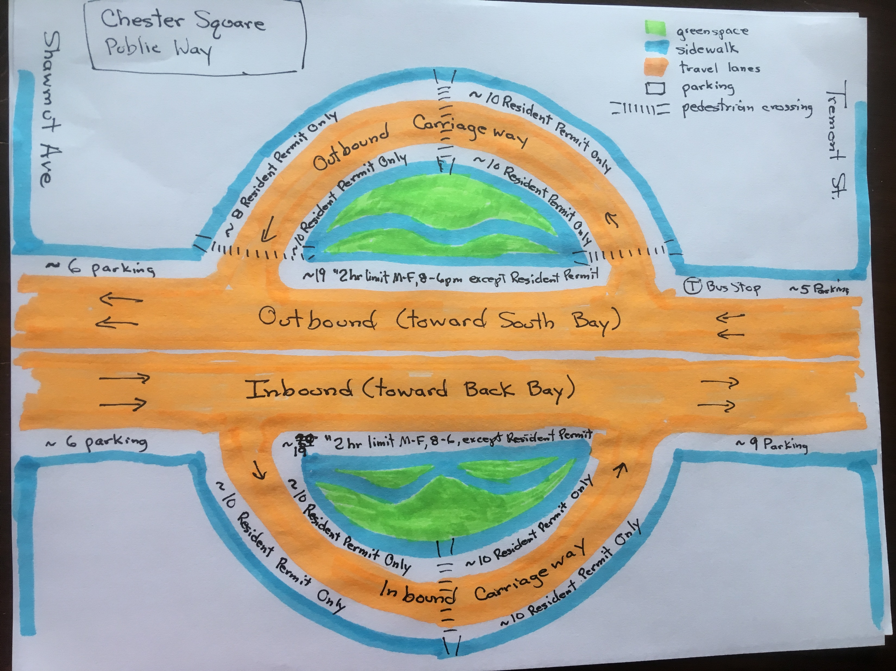
2019 sketch
Public way
allocations for
walking, cycling,
parking,
driving & buses,
and recreating

Slide 14
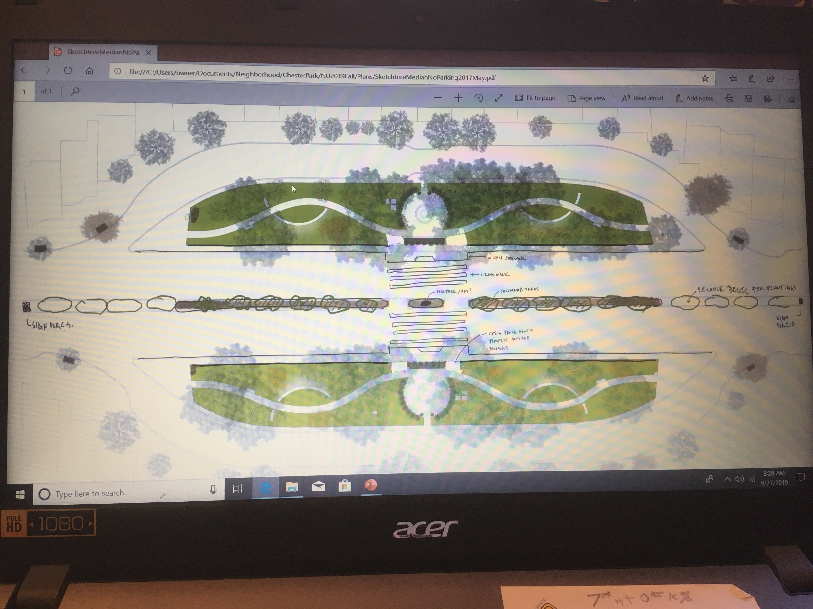
Chester Park Crossing
Vision for Chester Park Connection
Friends of Chester Park

Slide 15
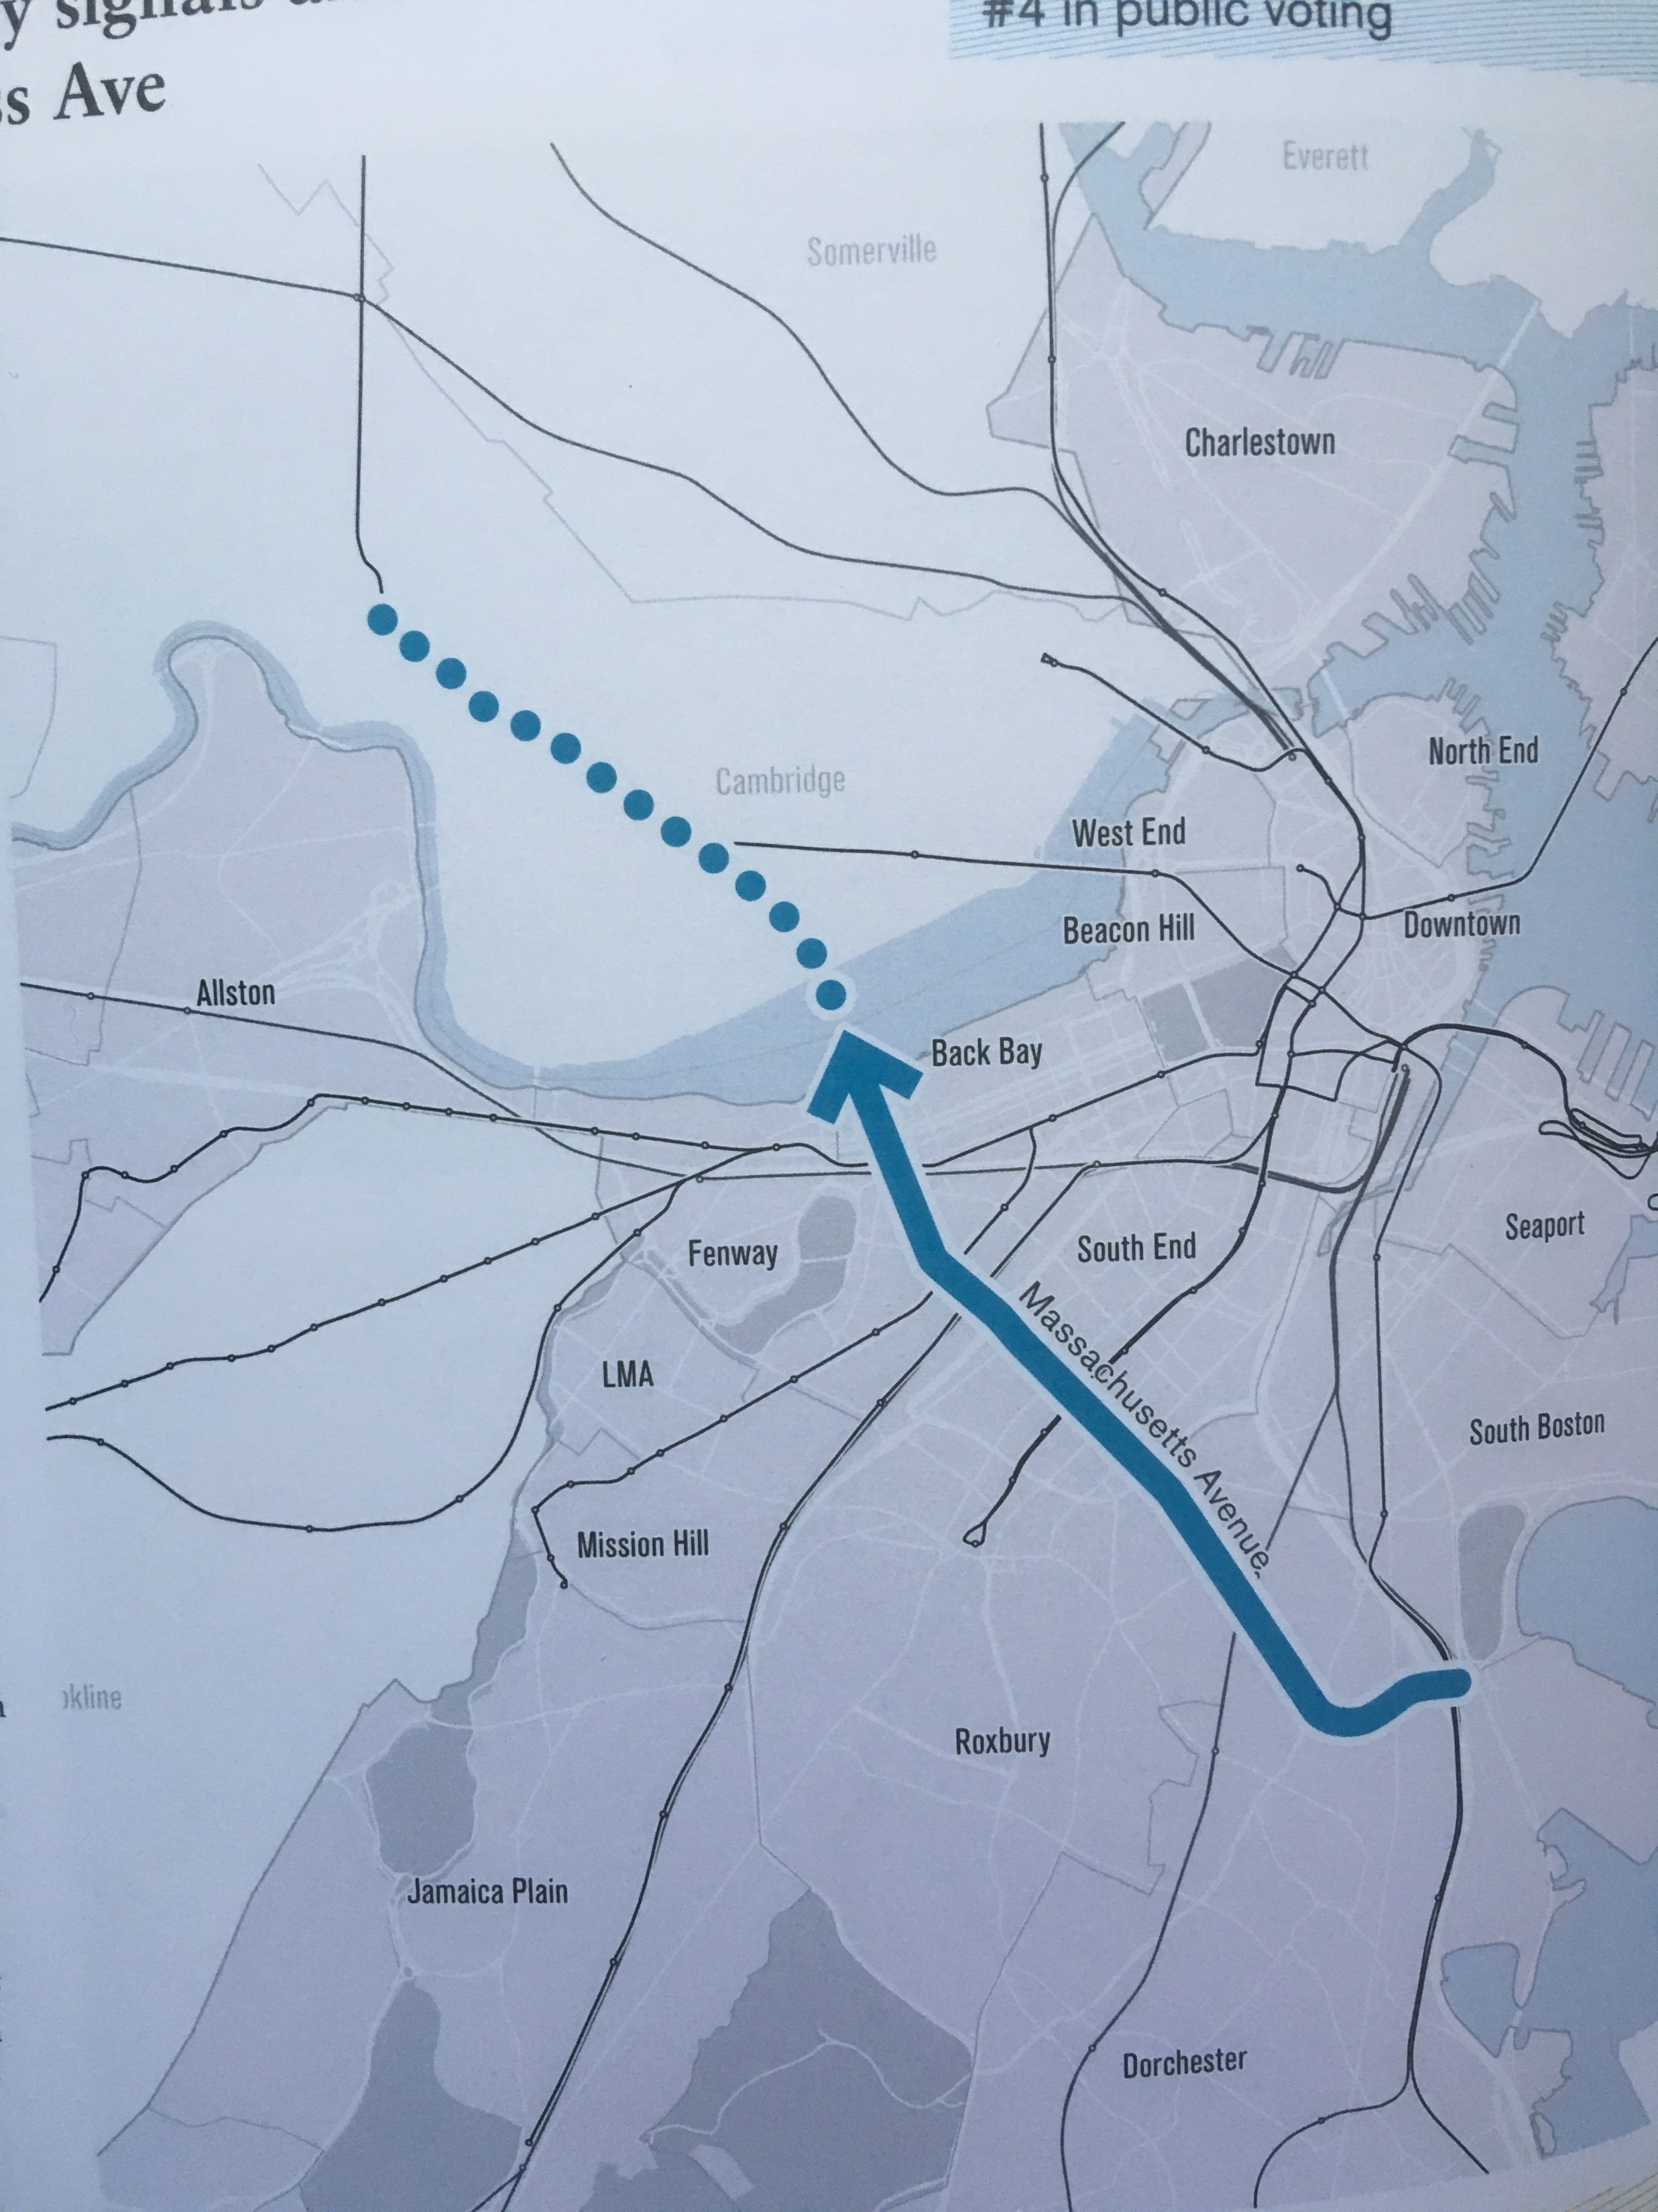
Bus Rapid Transit
From Harvard to U Mass
Go Boston 2030

Slide 16
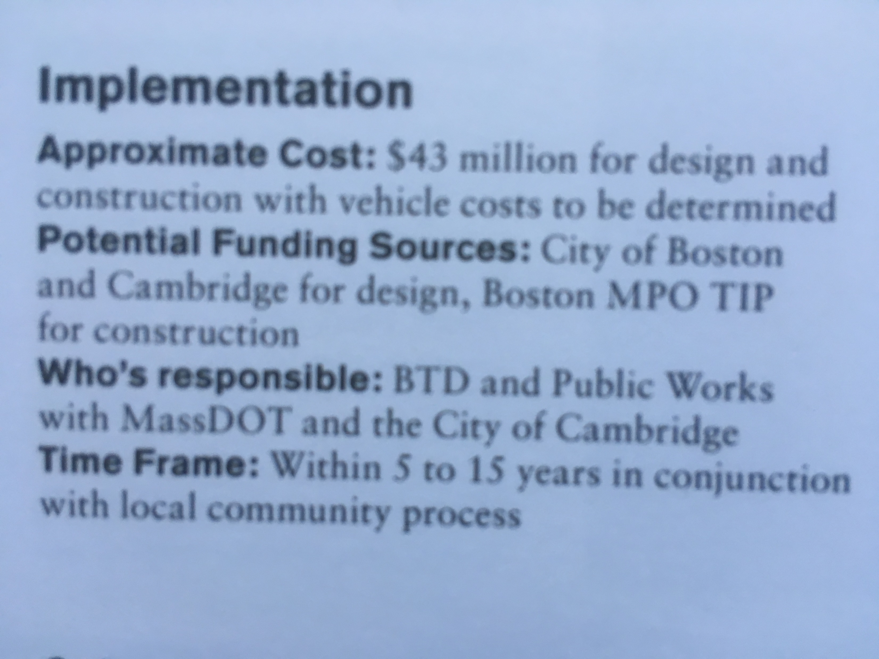
Bus Rapid Transit for Massachusetts Avenue:
From Go Boston 2030

Slide 17
Parking / Streetscape Problem Statement
Demand for parking exceeds supply. Residents, visitors, and people who work in the area, often find it challenging or impossible to park or avoid onerous penalties.
Public services and facilities exacerbate the problem by favoring private car ownership (allocation of right-of-way, taxes/fares/fees, traffic signal timing).
Poor access to curb, for drop-off/pick-up, deliveries, trash collection, buses, & emergency services, results in double parking and blocked traffic.
Streets & sidewalks are not sufficiently safe and comfortable to encourage healthy exercise and community interaction.

